Slide 1
Unpack your bookbag.
Use the restroom.
Sharpen your pencils.
Start your morning work.

Slide 2
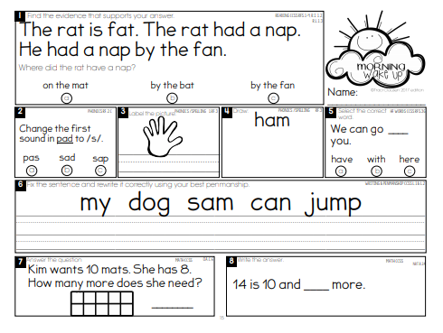
Complete this after class today.

Slide 3
Sight Words Review

Slide 4
List 5

Slide 5
her

Slide 6
fly

Slide 7
said

Slide 8
round

Slide 9
his

Slide 10
Run fast.

Slide 11
I want it.

Slide 12
We made it.

Slide 13
Go to sleep.

Slide 14
Spelling Words

Slide 15
scan

Slide 16
scat

Slide 17
skip

Slide 18
skid

Slide 19
stop

Slide 20
spot

Slide 21
snap

Slide 22
sniff

Slide 23
swell

Slide 24
swim

Slide 26
The kids know how to read these.

Slide 38
and
a
the

Slide 40
Dad
sat
on
the
log
.
Tom
had
a
dog
.
The
rat
had
a
nap
.

Slide 41
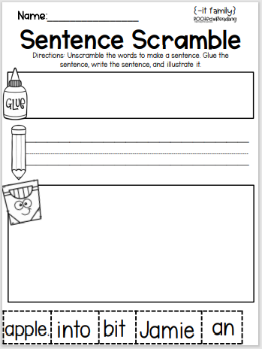
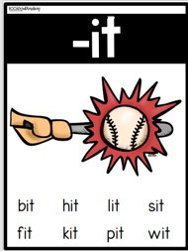

Slide 45
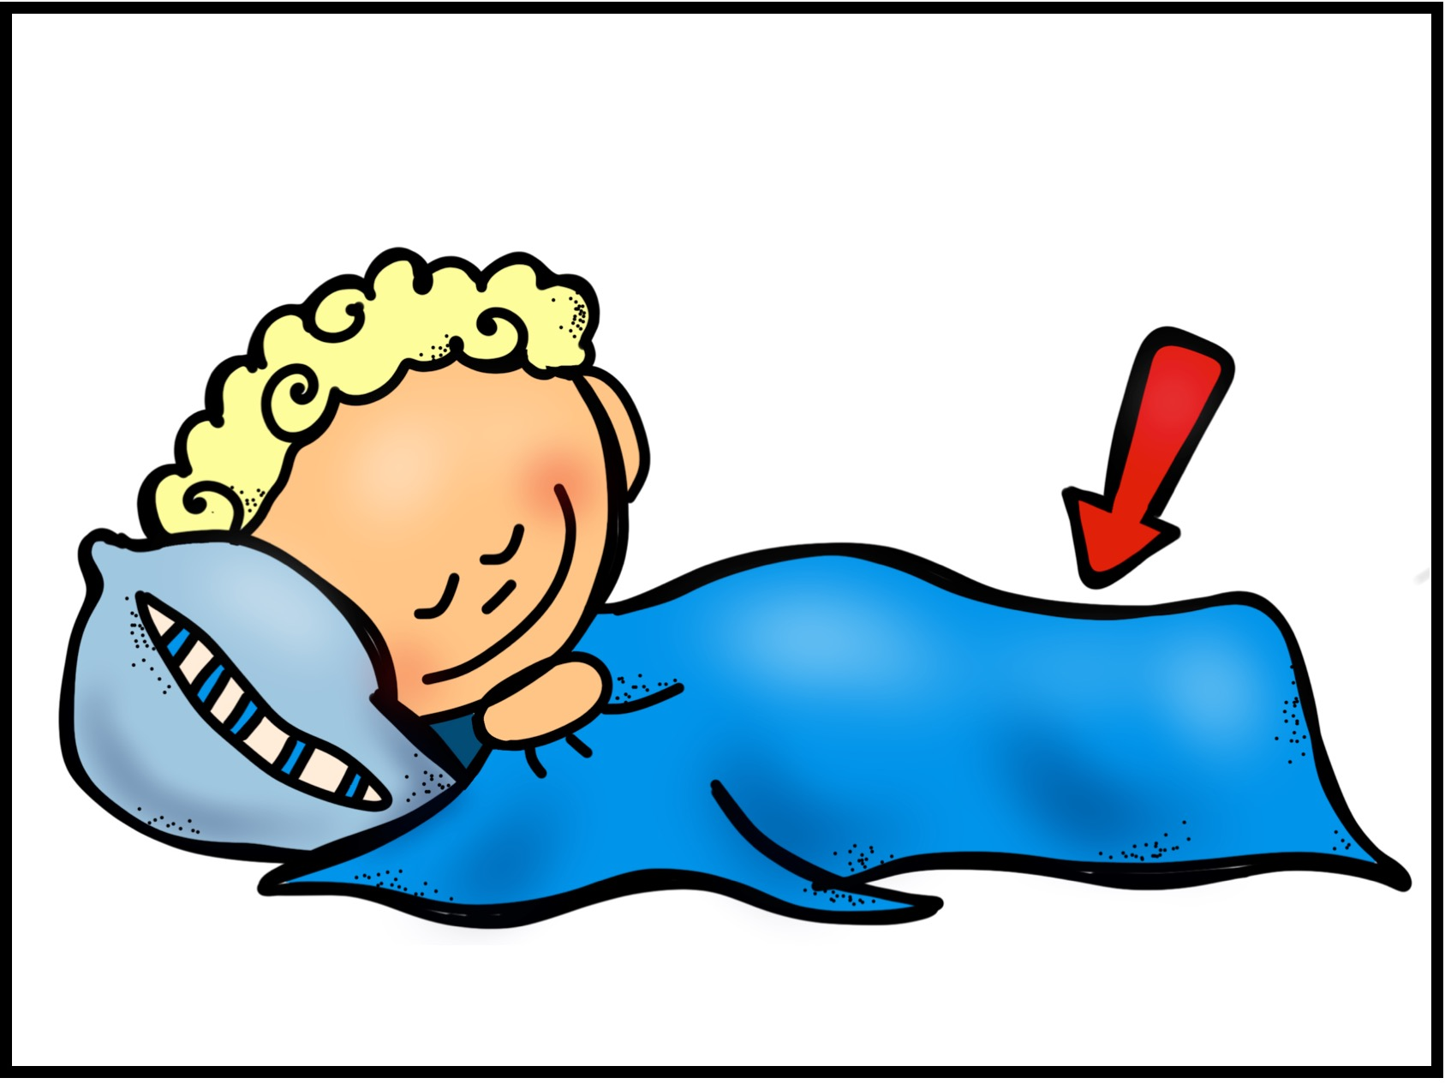

Slide 47
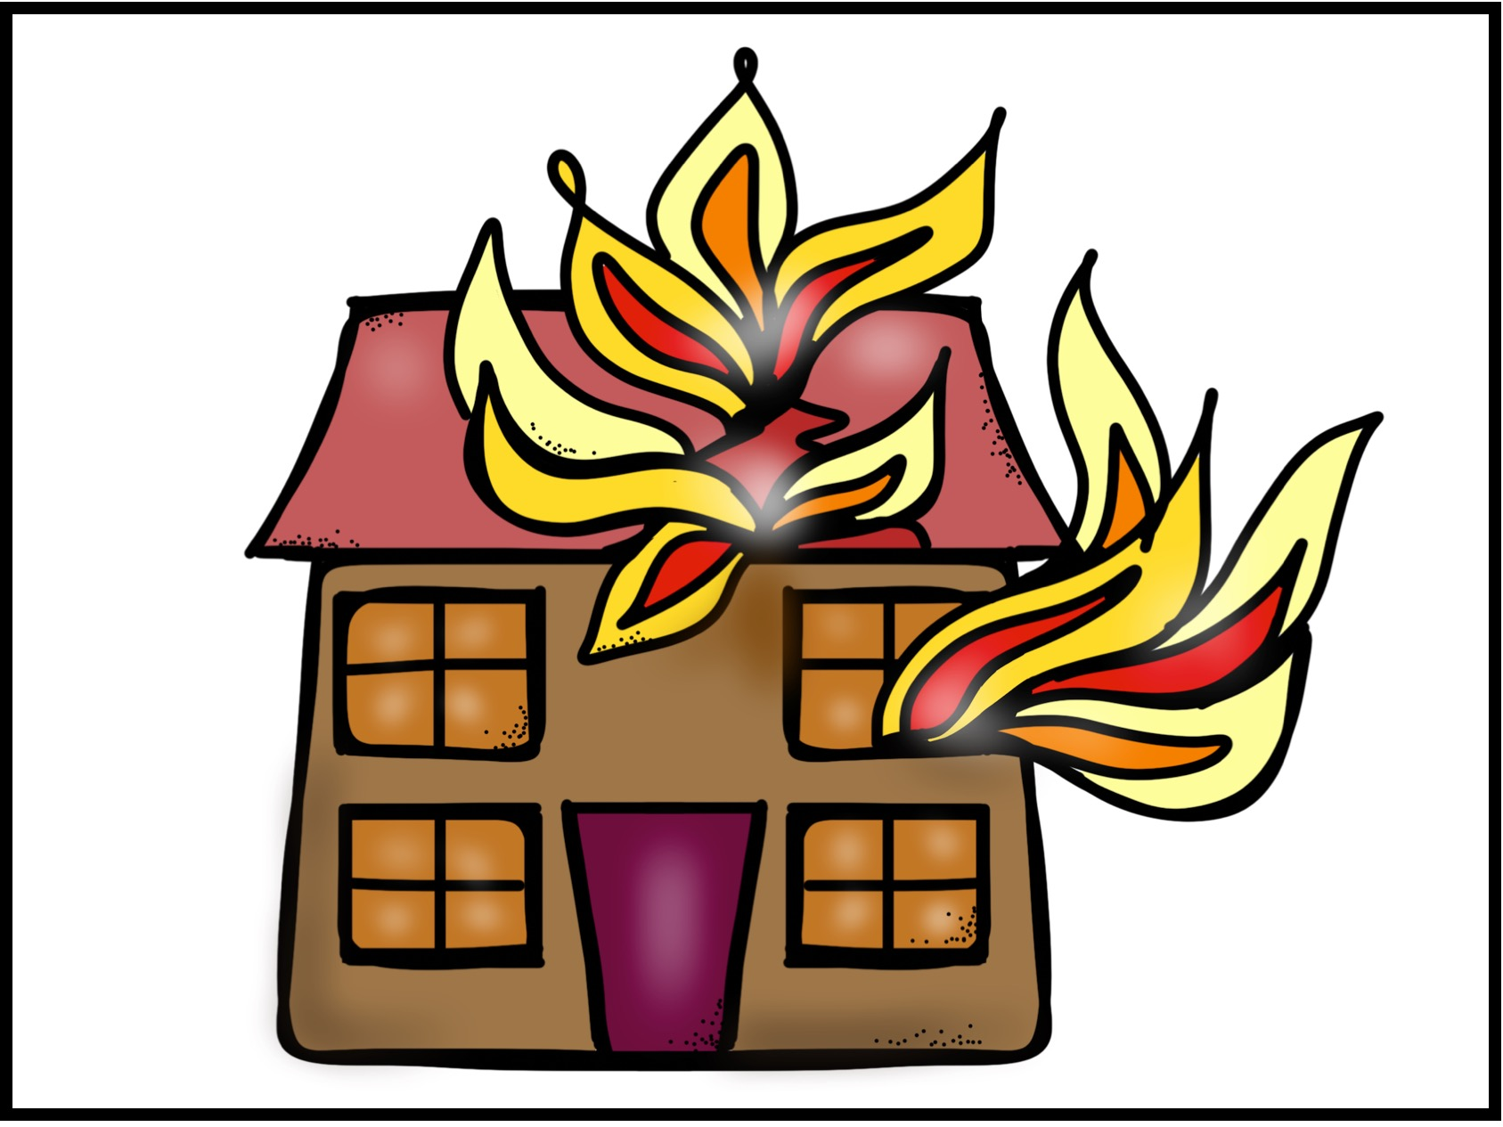

Slide 49
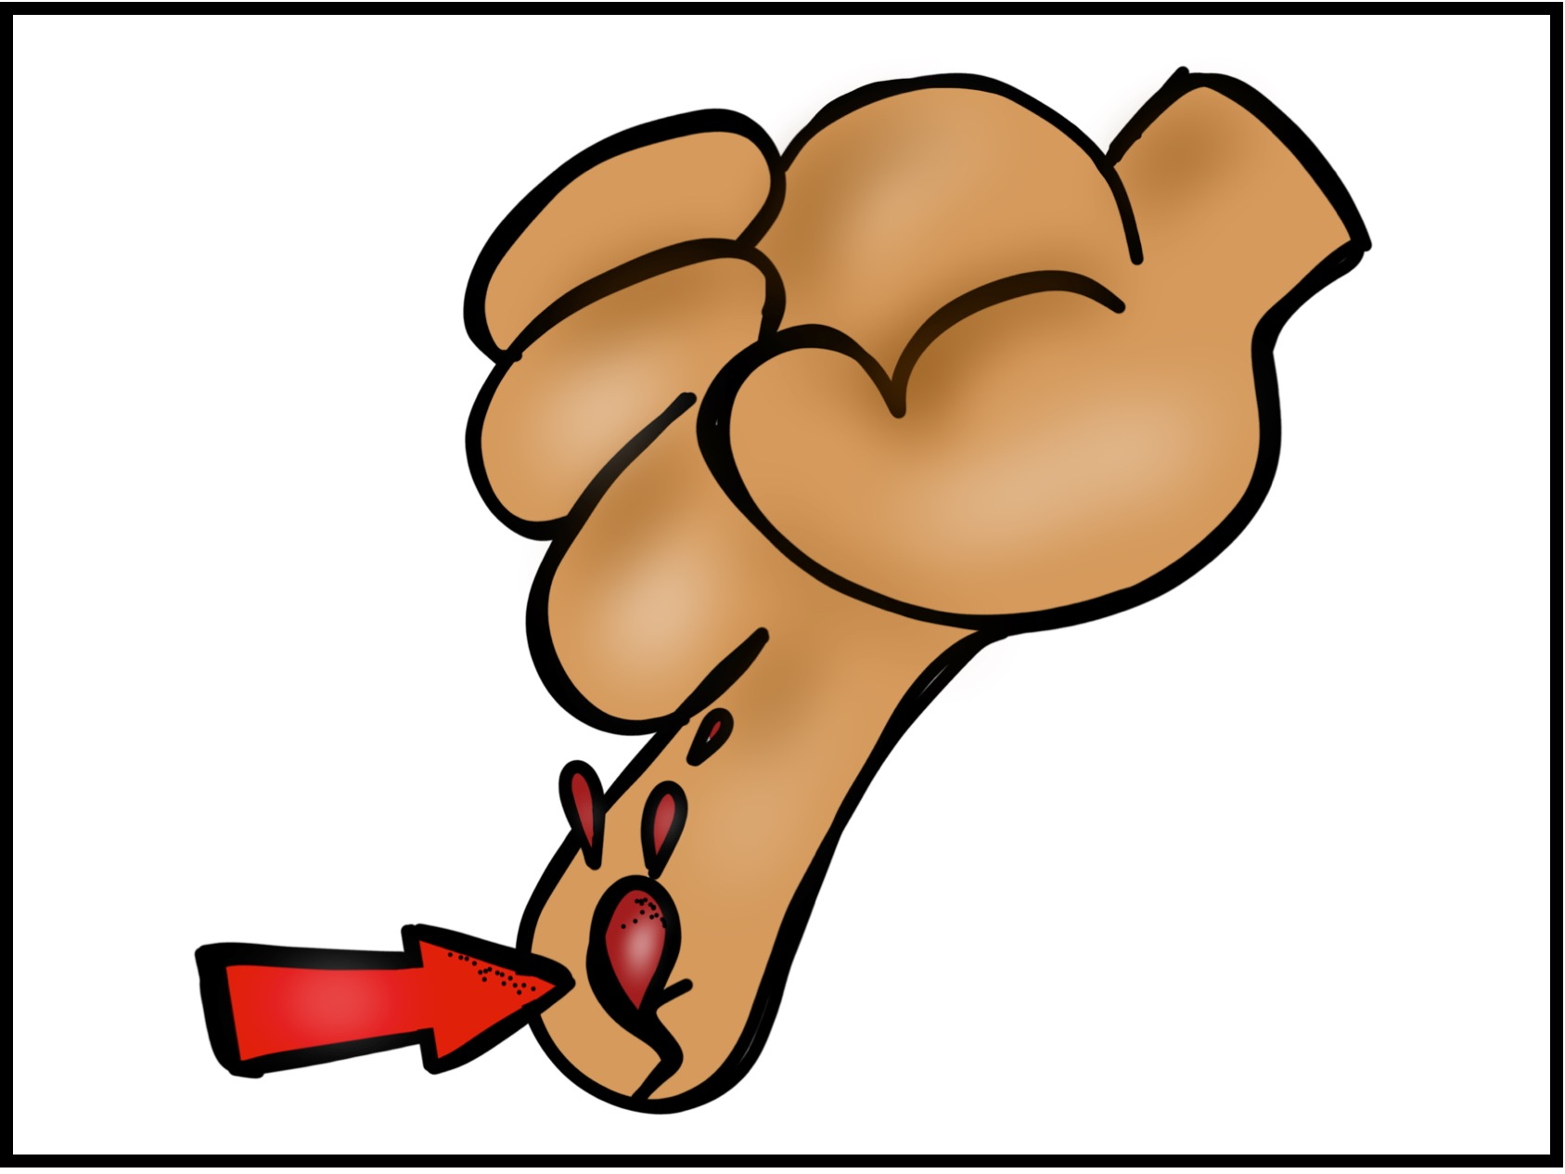

Slide 51
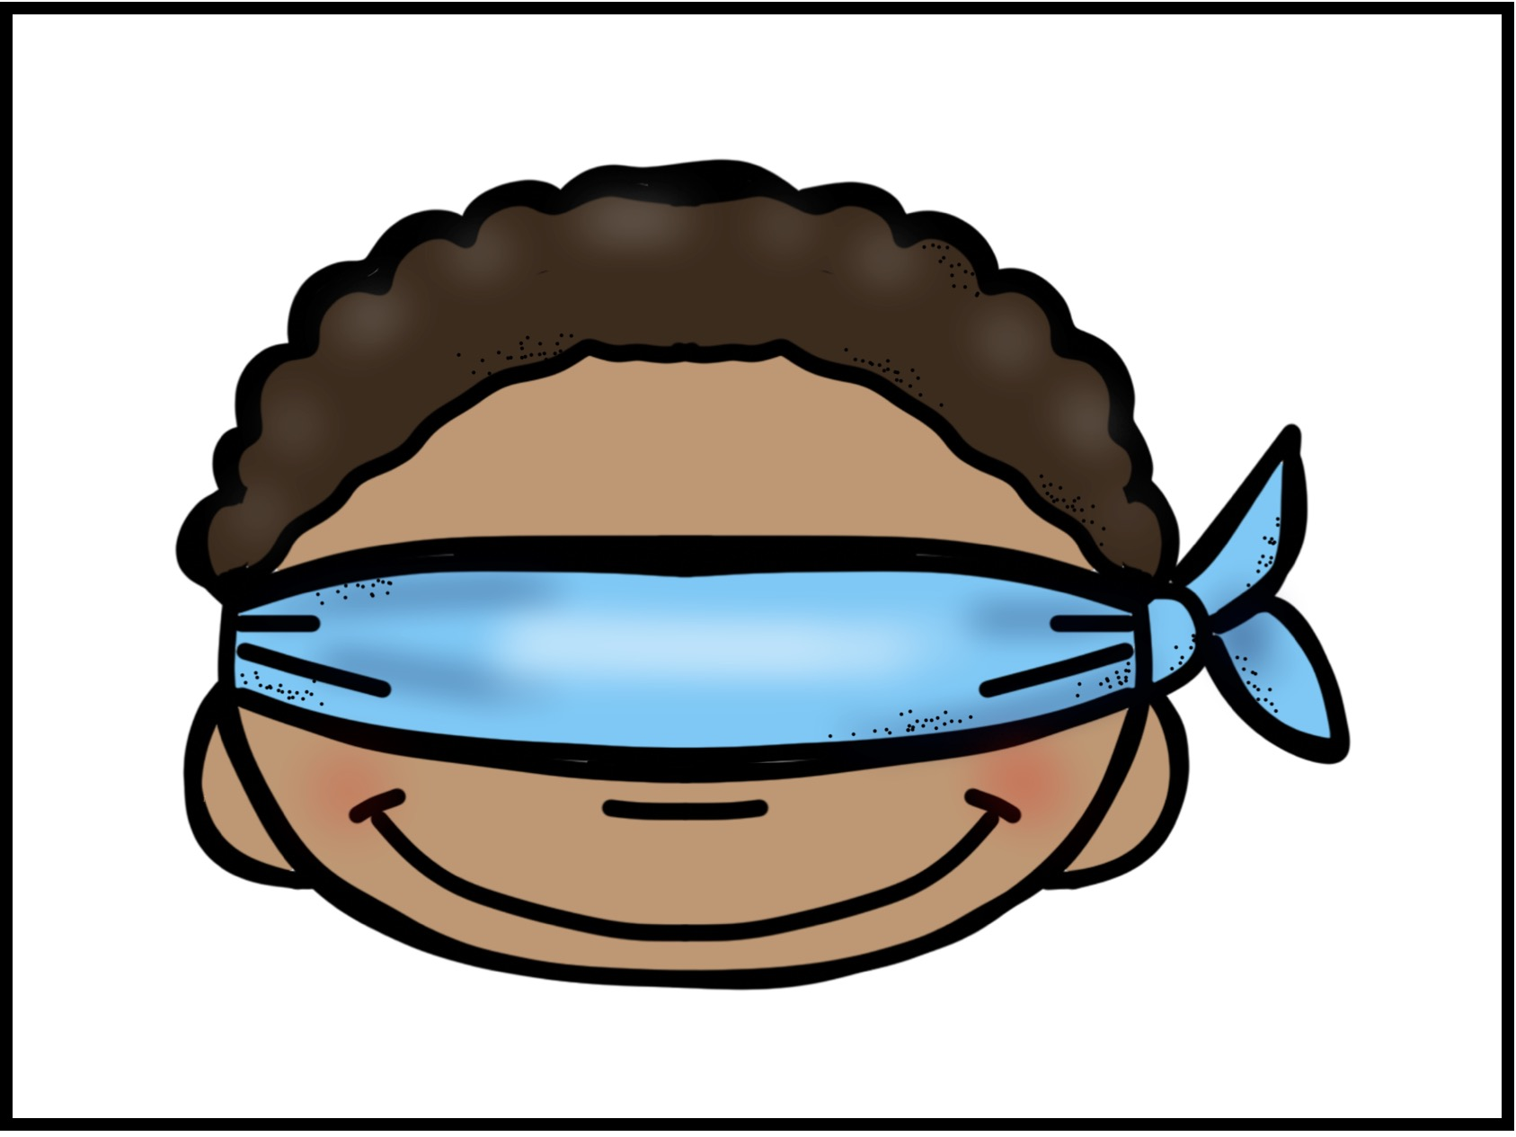

Slide 53
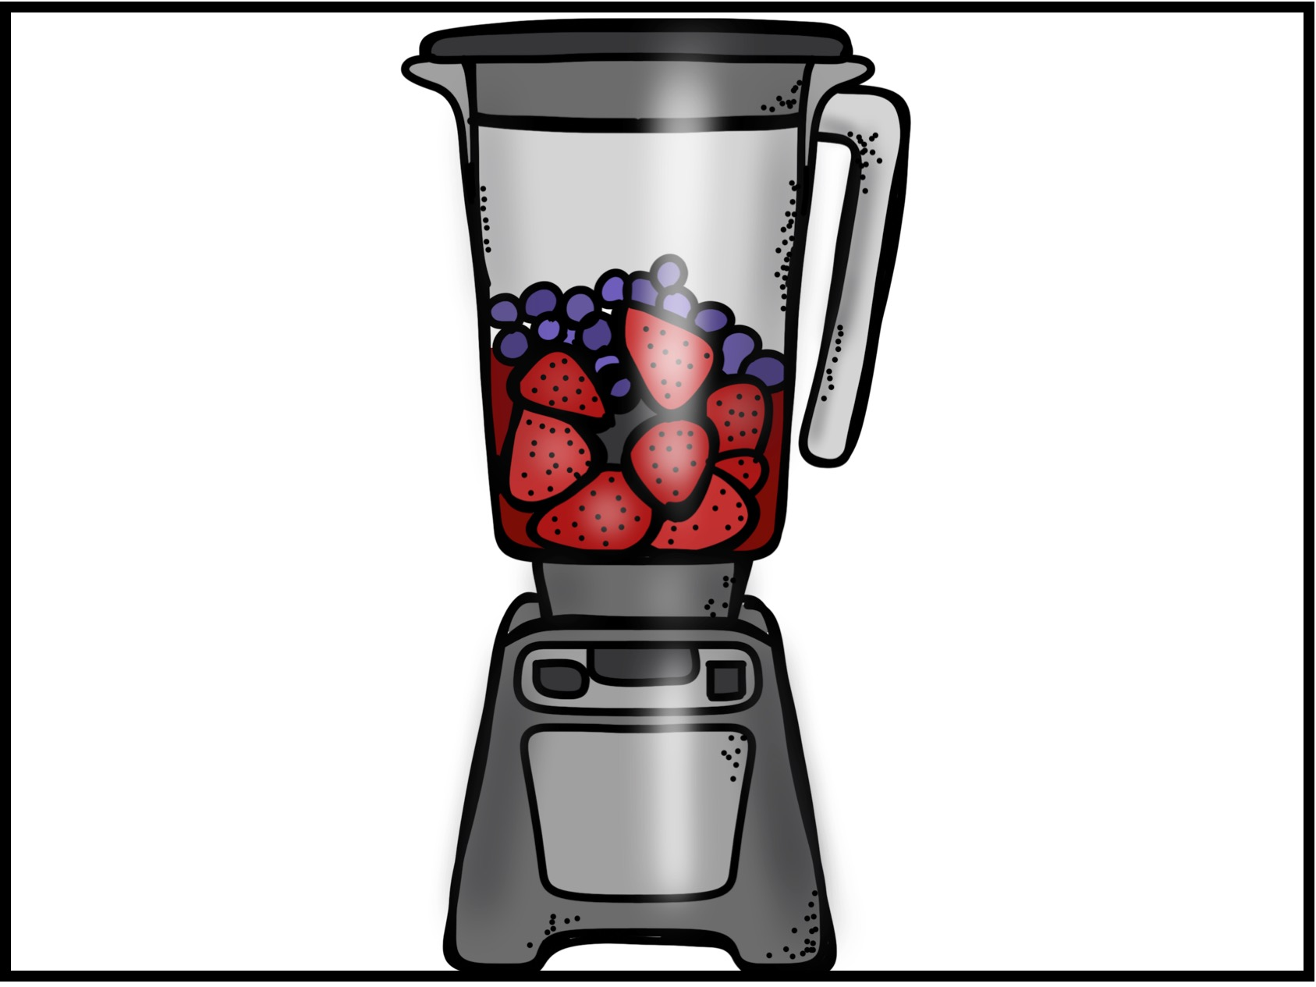

Slide 55
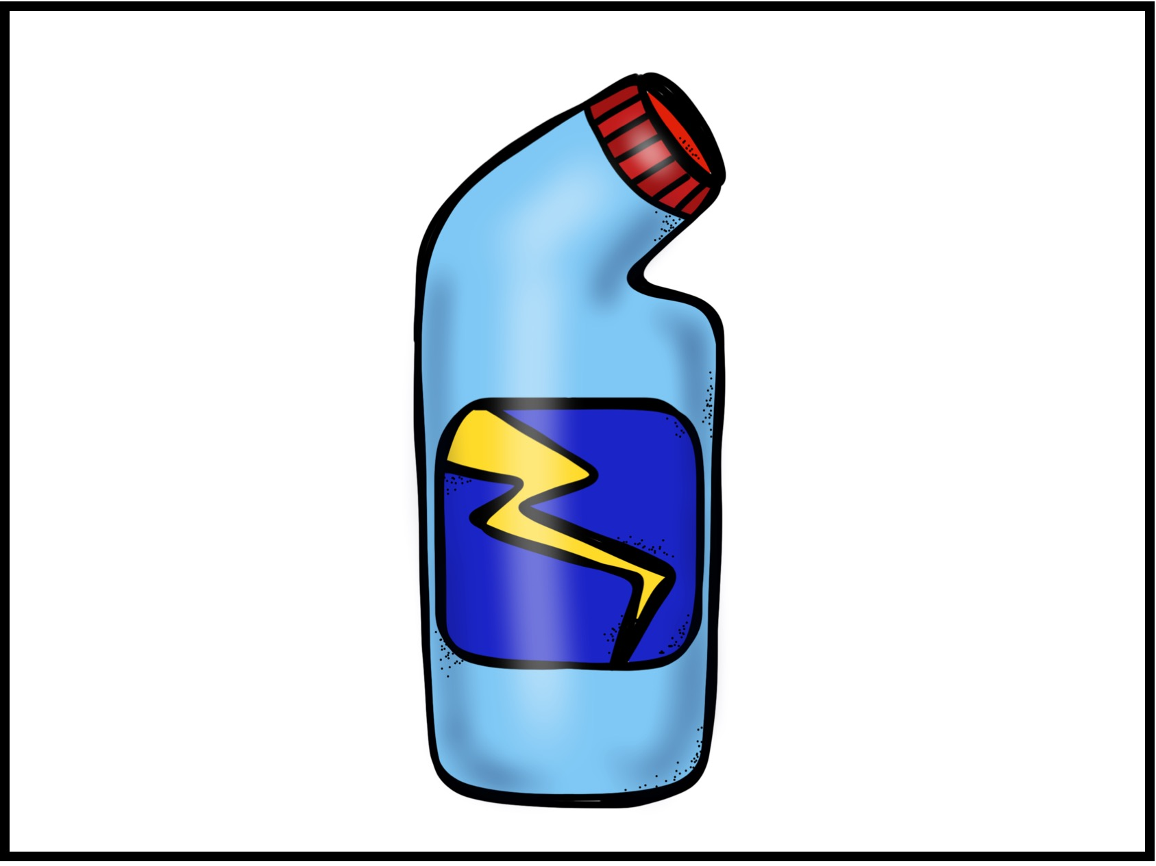

Slide 59
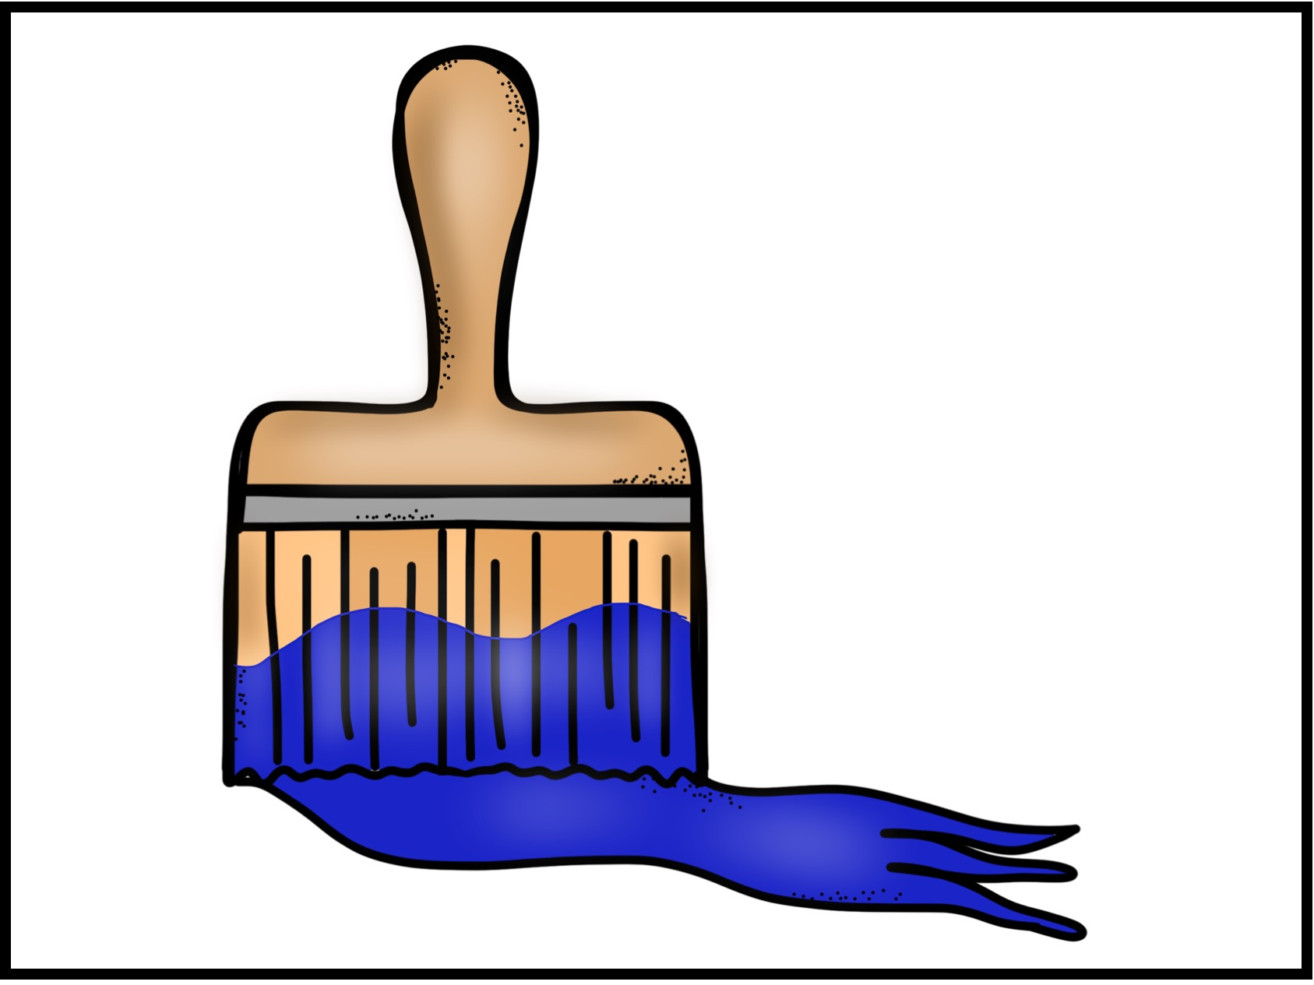

Slide 61
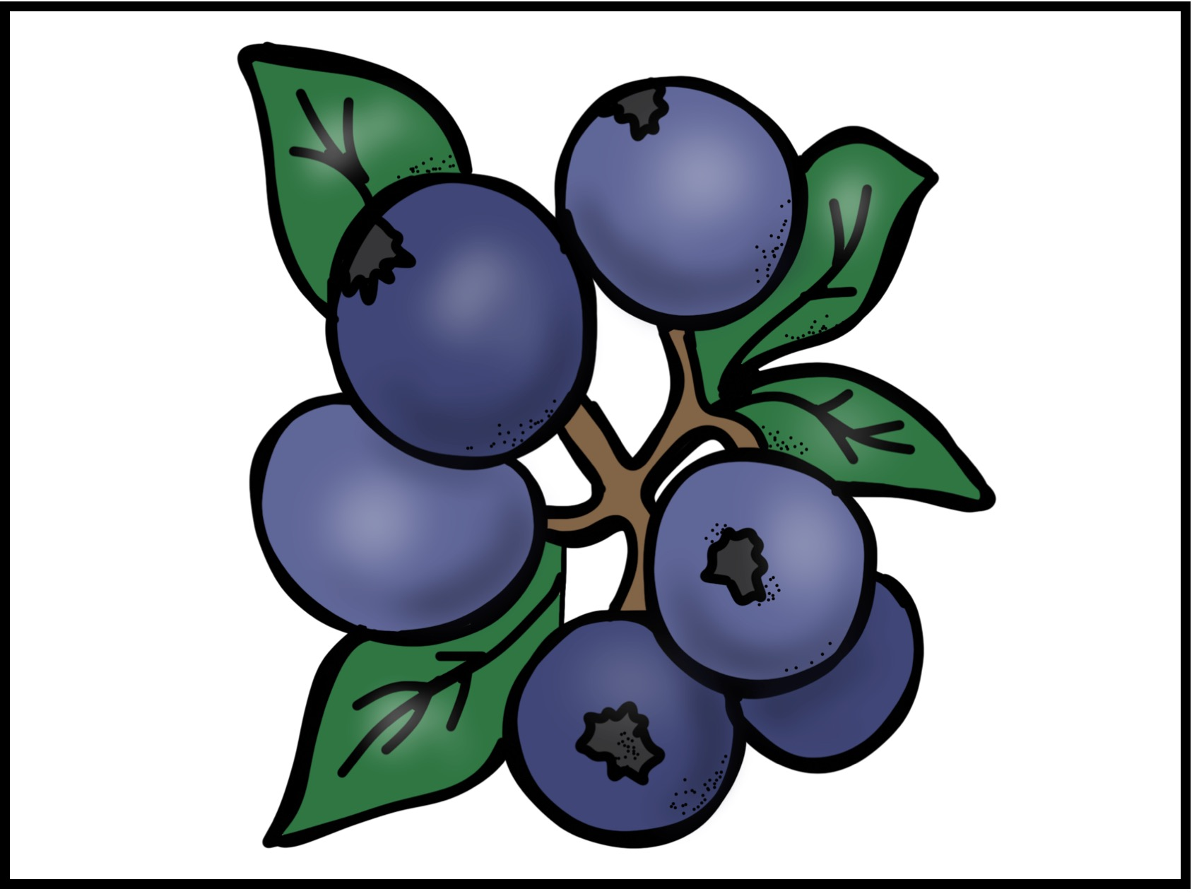

Slide 63
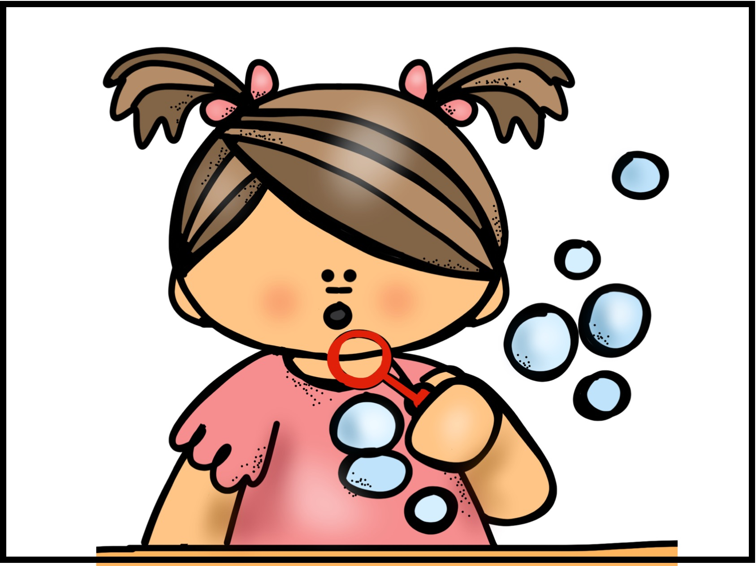

Slide 64
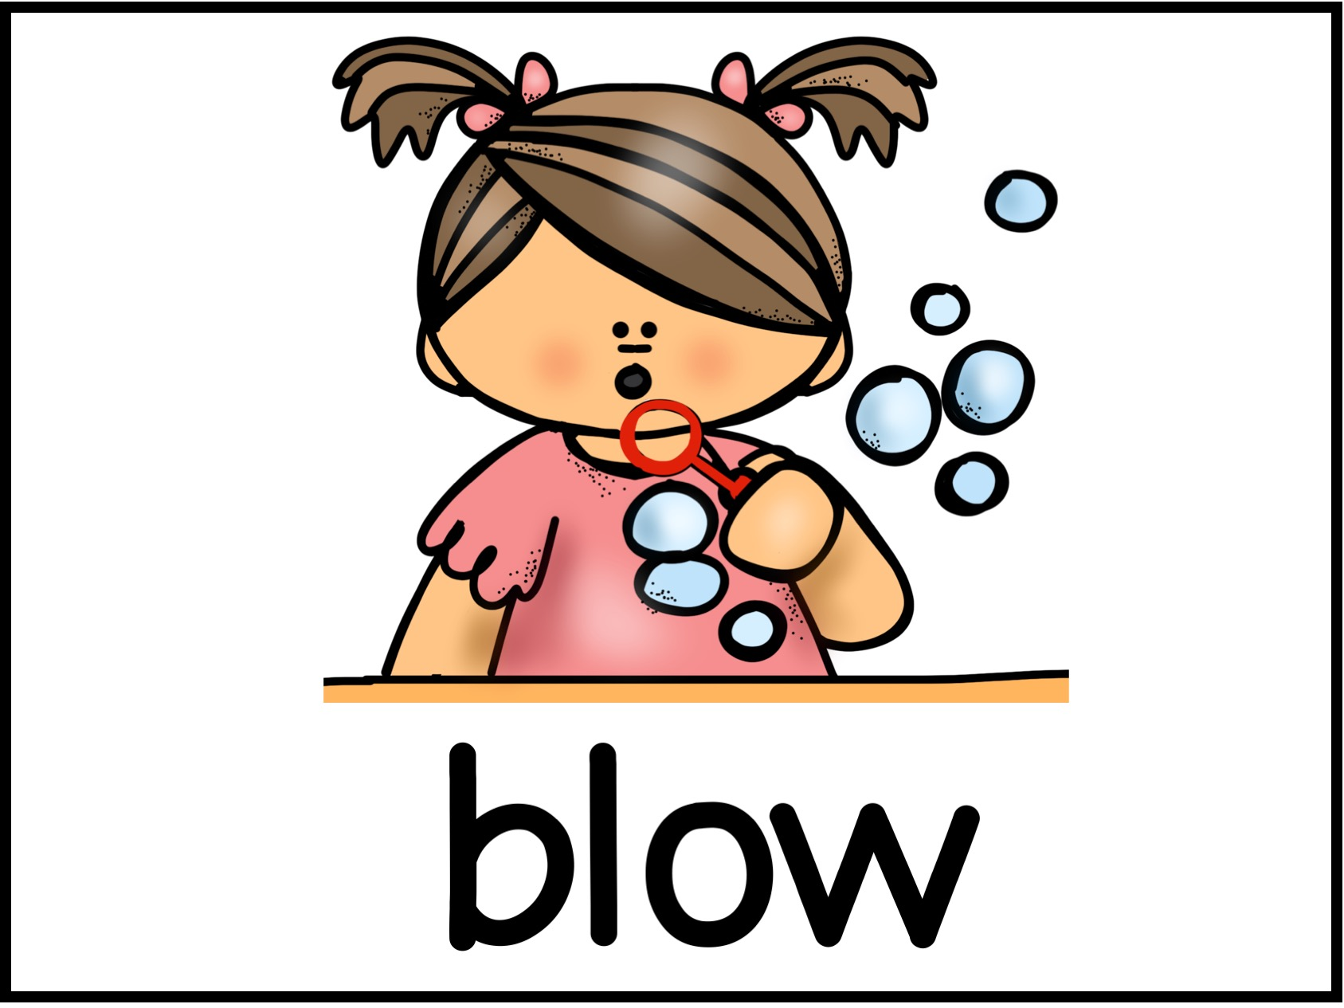

Slide 65
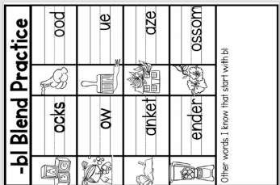

Slide 67
Let's Discuss the Story

Slide 68
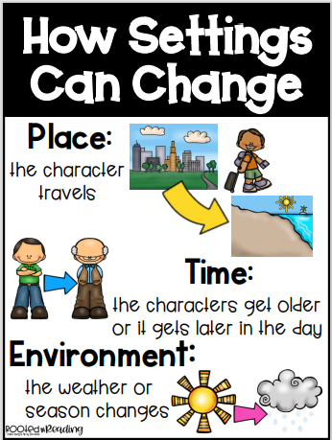

Slide 69
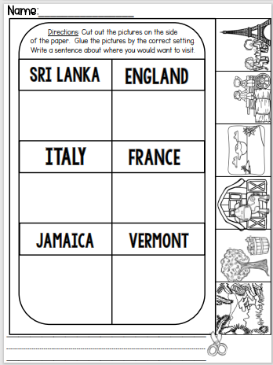

Slide 70
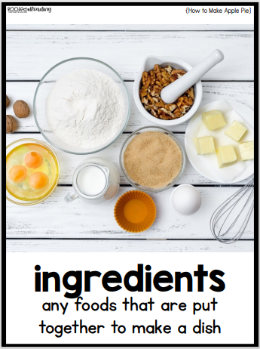
What Ingredients would you need to make apple pie?

Slide 71
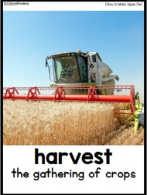
What are the different foods that we can harvest?

Slide 72
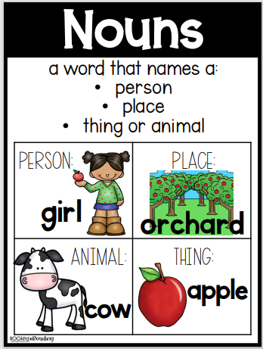

Slide 73
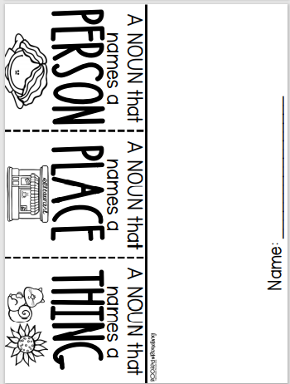
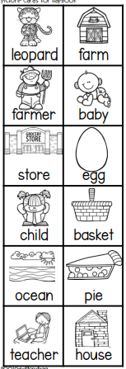

Slide 74
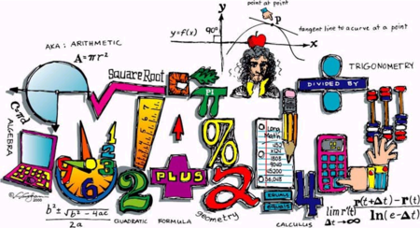

Slide 75
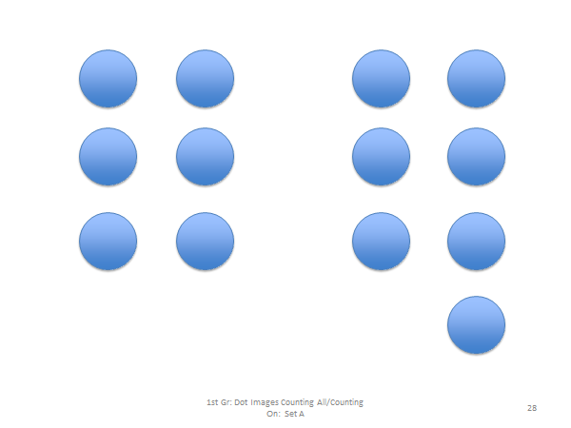

Slide 80
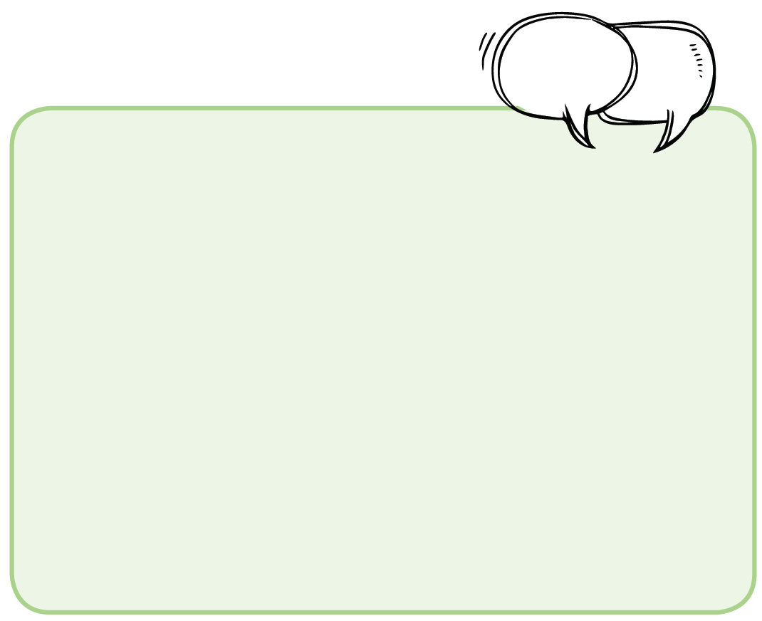
Notes:
Do we make a Grade 1 option with a smaller green box?

Slide 82
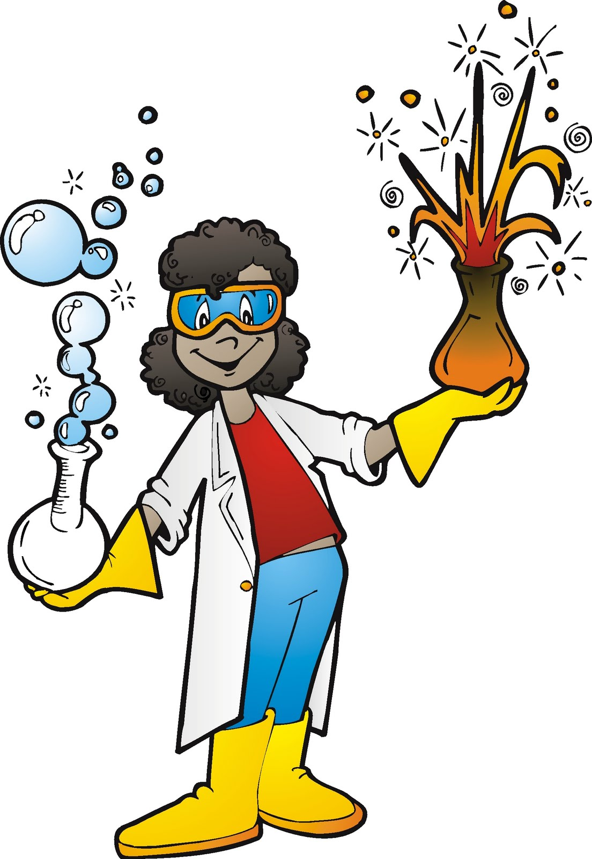
Science

